Slide 1
Year 5 Kick-Off Call
September 18, 2026

Slide 2
Agenda
Welcome
Introductions
Year 5 Focus
Program Updates
FY 26 Data Summary
Data Entry & Patient Navigation Reminders
Communications & Outreach
Business Reminders
Provider Opportunities
Q & A
Notes:
This webinar is being recorded
All participants will be on mute until the Q &A portion of the agenda
Feel free to use chat for questions prior to the Q &A

Slide 3

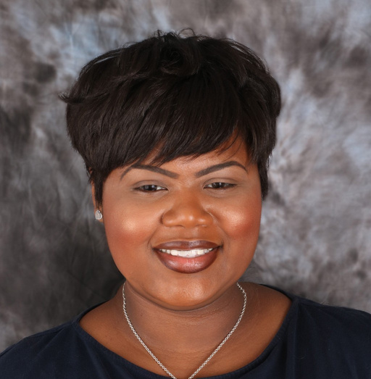
LBCHP Team | Program Management
Carleigh Baudoin
LCP Assistant Director/
LBCHP Manager
Brooke Stewart
Assistant Manager
General questions
Billing/Invoicing
Contracts
Budgets
Material requests
General questions
Contracts
Budgets

Slide 4
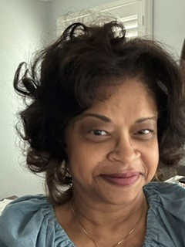
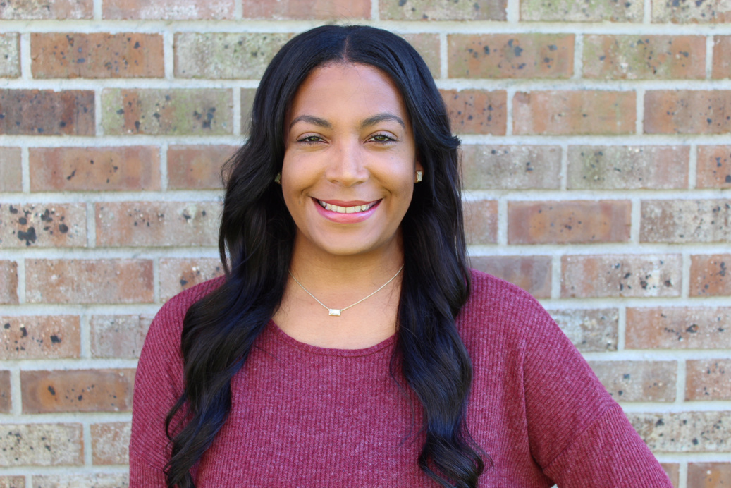
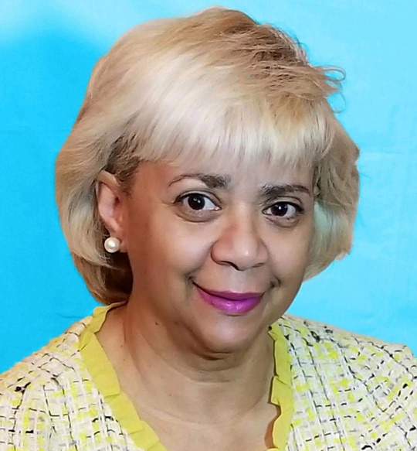
LBCHP Team | Clinical & Patient Navigation
Tyler Bartley
Patient Navigation Coordinator
Denise Cox
Patient Navigator
Dr. Denise Johnson
Clinical Advisor
Clinical questions
Patient navigation questions
BCC Medicaid
Referrals to University Medical Center
Online referral/RedCap Questions
Clinical questions
Diagnostic referrals to St. Thomas

Slide 5
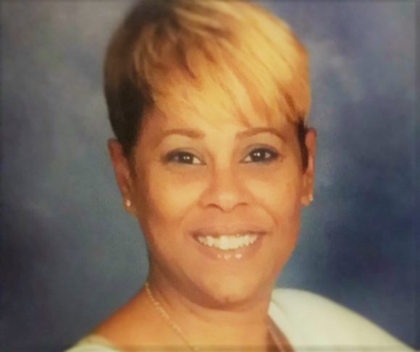
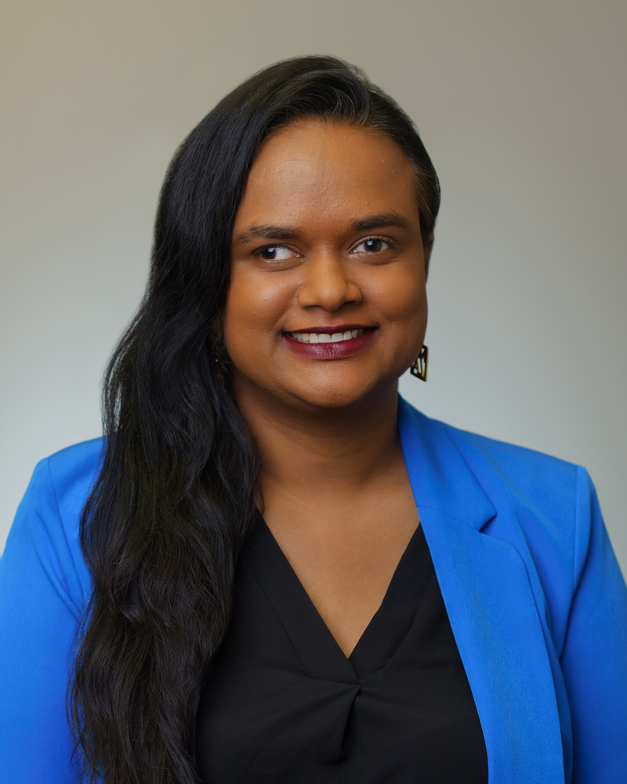
LBCHP Team | Data & Catalyst120 Support
Zina Daniel
Data Coordinator
Malesa Periera
Evaluation Manager
Data & Catalyst 120 Questions
Data questions
Catalyst120 access

Slide 6
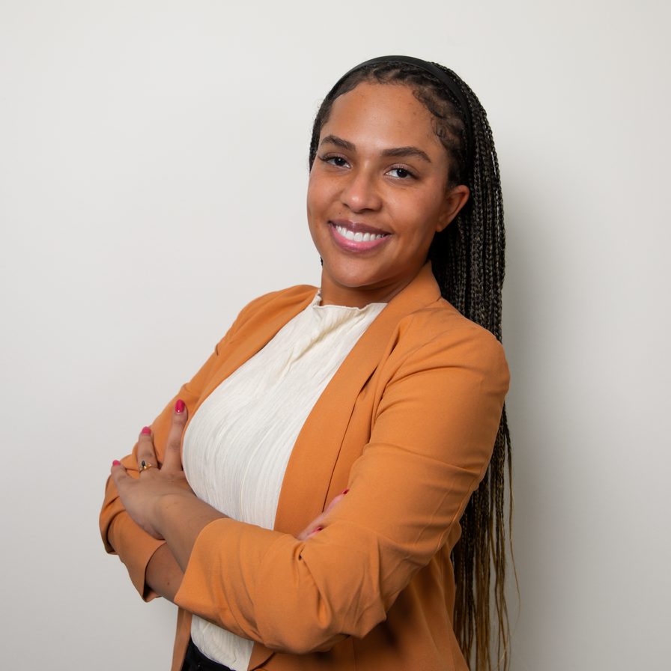
LBCHP Team | Communications
Leiana Pineda Gonzales-Rubio
Communications Coordinator
Communications requests or support

Slide 7
Introductions
Name
Where you are from (city & facility/clinic)
LBCHP role
How long have you been working with LBCHP?

Slide 8
Year 5 Focus
Grant Year: 6/30/26-6/29/27 (Grant period: 6/30/22-6/29/27)
Priorities
Increase service delivery to uninsured and underinsured women
Continue to partner with existing providers and identify new providers in target areas of the state
Enhance outreach efforts to link/refer women in the community to LBCHP clinical services
  Expand partnerships with community-based groups serving populations of focus
  Increase communications and marketing efforts

Slide 9
Year 5 Timeline
Quarter 2 Provider Calls
October/November 2026
New Funding Opportunity Released
November/ December 2026
Grant Application Due
February 2027
Quarter 3 Provider Calls
February/March 2026
Spring MDE Submission
April 15, 2027
Final Amendments
April 30, 2027
Provider Continuation Application
May 30, 2027
Fall MDE Submission
October 15, 2027
Final Budget Modifications
June 15, 2027
Final Invoices Due
July 7, 2027
Quarter 4 Provider Calls
May/June 2027

Slide 10

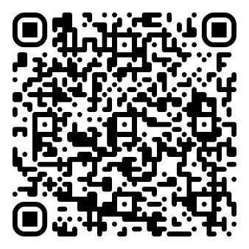

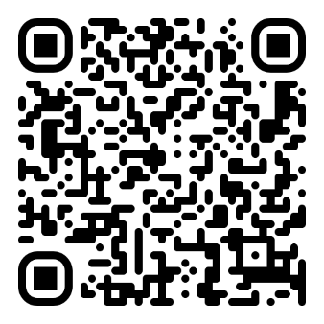
Program Updates
Bayou Blueprint: Cervical Cancer Elimination Plan
Reimbursement Updates:
  HPV Self-Collection
    In-Clinic and Home (Approved home tests= Teal and Onclarity)
    CPT Code: 87626
  Pelvic Exam
    CPT Code: 99459
    Note: Cervical cancer screening must be conducted to be reimbursed.
Scan to Download the Plan
Scan for HPV-Self Collection Materials

Slide 11
FY 26 Data Summary

Slide 12
LBCHP Services Trends
Medicaid Expansion
PN Only Start
COVID-19

Slide 13
Years 1-4 Highlights
Diagnosed
Served
Cervical Cancer Quality
Breast Cancer
Quality
145 Breast Cancers
34 Cervical Cancers
9,998 Breast
4,059 Cervical
54.8 % rarely/never screened for cervical cancer
87.2% completed diagnostic follow-up
83% time between screening and final diagnosis < 60 days
95.6 % completed diagnostic follow-up
96.4 % time between screening and final diagnosis < 60 days
100% treatment started

Slide 14

https://sph.lsuhsc.edu/louisiana-tumor-registry/

Slide 15
Data Entry & Patient Navigation Reminders

Slide 16
Data Entry Reminders
Bi-annual submission is on October 15th. Data entry through 6/30/26 is complete. Thanks for all your hard work!
  If you have data from before 6/30/26 to enter, please contact Zina.
Remember to hold off on entering cases into Catalyst until you have completed follow-up.
Reminder to fill out the diagnosis page if required (i.e., ultrasound, colposcopy, biopsy, etc. was completed)
Any questions? Please contact Zina Daniel (zdanie@lsuhsc.edu) or Malesa Pereira (mperei@lsuhsc.edu)

Slide 17
Navigation Reminders
Two or more contacts are required for navigation, and preferably more for diagnostic cases.
Document all diagnostic patients in Catalyst to completion. This allows us to collect all required cancer data if the patient is diagnosed.
Care coordination is important. Touch base with other navigators and other appropriate contacts to schedule follow-up tests and/or treatment as needed.
If any complicated or unusual situations with patients arise, feel free to call Tyler Bartley to discuss options or talk through program guidelines. She is always available to assist.
Review the CAGNO/CALA process and eligibility requirements. Feel free to call Tyler to discuss.
Reminder: All navigation is paid by the program.

Slide 18
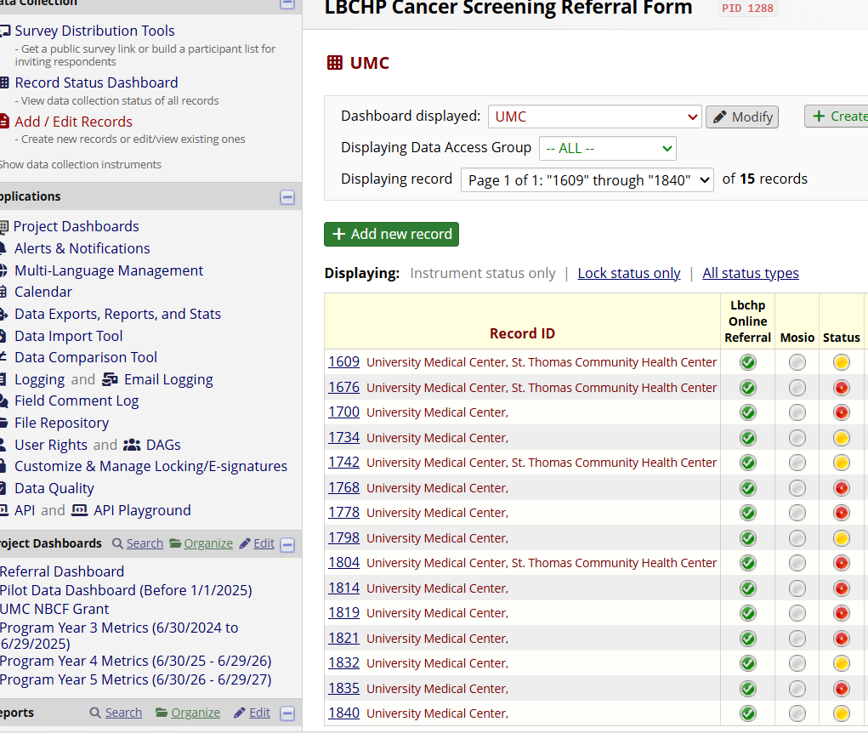
Online Referral Reminders
Check REDCap referrals regularly to ensure timely follow-up and continuity of care.
All REDCap entries should include current notes and accurate dates to ensure proper tracking and reporting.
All patients should receive at least 3 documented contact attempts before closing the referral.
Once completed, be sure to make the entry as complete.
Tips

Slide 19
Communications & Outreach

Slide 20
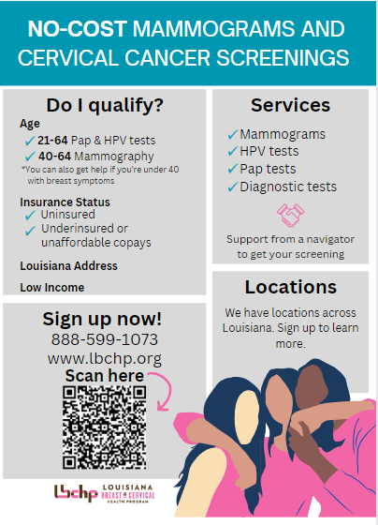
Marketing Milestones
Minimum Requirement: Complete at minimum 1 new activity per quarter (total 4 or more for the year)
  Engage in a diverse set of activities for the year (i.e. combination of in-clinic/in-reach, outreach, and online)
  Some activities can be counted once, others can be completed and counted multiple times .
  For outreach or events remember to focus on LBCHP eligible population
Notes:
We need your support to expand marketing and outreach efforts across the state so that women know about and can utilize LBCHP.
We’ve simplified the guidance and minimum requirements for MM. We hope that this makes it easier to identify opportunities for marketing and outreach

Slide 21
Tracking & Getting Credit
Email Brooke Stewart (bste10@lsuhsc.edu) by the end of each quarter with information about completed marketing activities.
  You will need to provide a brief description and documentation of activity completion.
  Credit for completing activities will be reflected in your quarterly scorecard.
LBCHP developed a table to help you track your efforts. You do not have to submit this table to LBCHP.

Slide 22
Sample Annual MM activities
Quarter 1
Quarter 2
Quarter 3
Quarter 4
Placed banner or LBCHP poster in waiting area
Re-shared an LBCHP post through the providers social media channels
Participated in a health fair
Included LBCHP information within provider newsletter
Send a picture to LBCHP by end of Q1
Send a screen shot to LBCHP by end of Q2
Send a picture of event to LBCHP by end of Q3
Share a copy of newsletter to LBCHP by end of Q4

Slide 23
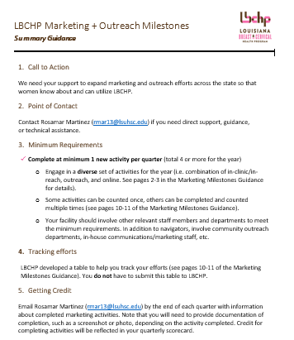
Due Dates
Q1 - Send by September 30, 2026
Q2 – Send by December 20, 2026
Q3 – Send by March 31, 2027
Q4 – Send by June 30, 2027

Slide 24
Promoting LBCHP Services Digitally
Social Media
  Develop a plan and promote awareness and provide educational information about breast and cervical cancer through Facebook and Instagram during Breast Cancer Awareness Month, Cervical Cancer Awareness Month, and beyond
  Navigator and Clinic Profiles
    Periodically promote our partner clinics and navigators on our social pages
    Needs: Navigator headshots and short bios
  Call to action - re-share our content
Sponsored Message
  Goal: To direct women to the online referral form/RedCap
  Ad will run throughout October on Facebook and Instagram in certain regions (opportunities to collaborate).
Outreach

Slide 25
Business Reminders

Slide 26
Reminders
Submit accurate monthly invoices to the LBCHP business office e-mail address (lbchpbusiness@lsuhsc.edu) by the 15th of each month; the final invoice will be due July 7, 2027 (date subject to change);
Submit invoices with all necessary supporting documents;
Submit invoices using only the LBCHP-provided template for the facility;
Communicate with the LBCHP business office to resolve issues with invoices or contracting; and
Contact the LBCHP business office as early as possible with any invoice/contract questions (e.g., reimbursable supplies).

Slide 27
Q&A

Slide 28







Learn More About LBCHP
- 1-888-599-1073
- LBCHP.org
- @LouisianaCancer
- @LouisianaCancer
- @LouisianaCancerPrevention
- Louisiana Cancer Prevention & Control Programs

