Slide 1
YEAR 4 KICK-OFF
September 12, 2025

Slide 2
AGENDA
Welcome & Introduction
FY 25 Data Summary
Data Entry & Patient Navigation Reminders
Communications & Outreach
Business Reminders
Provider Opportunities
Q & A

Slide 3
YEAR 4 FOCUS
Grant Year: 6/30/25-6/29/26 (Grant period: 6/30/22-6/29/27)
Priorities
Increase service delivery to uninsured and underinsured women.
Continue to partner with existing providers and identify new providers in target areas of the state.
Enhance outreach efforts to link/refer women in the community to LBCHP clinical services.
  Expand partnerships with community-based groups serving populations of focus.
  Increase communications and marketing efforts
Notes:
This webinar is being recorded
All participants will be on mute until the Q &A portion of the agenda
Feel free to use chat for questions prior to the Q &A

Slide 4
LBCHP SERVICE TRENDS
Medicaid Expansion
PN Only Start
COVID-19
Notes:
This slide shows trends in our service delivery from FY07 to FY21. Many factors have impacted service delivery numbers, most recently COVID-19.
FY21
Breast Screening: 1,940
Cervical Cancer: 886
PN Only: 4,195
Women served (any breast or cervical procedure): 2,618

Slide 5
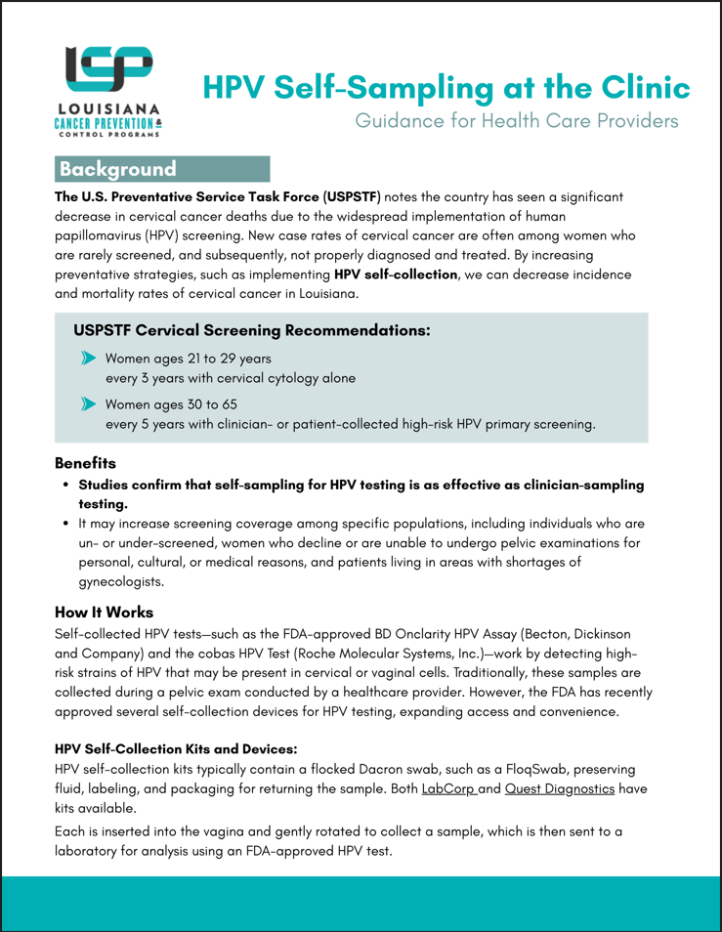
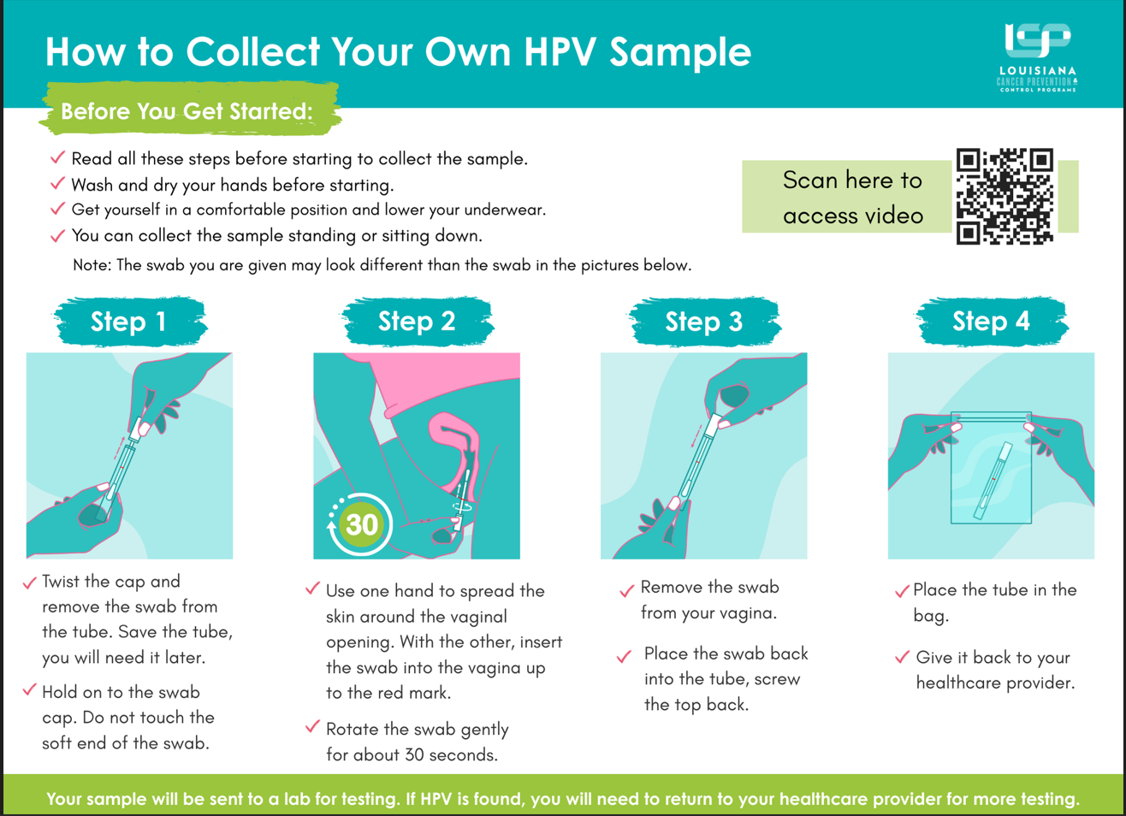
PROGRAM UPDATES
HPV Self-Collection
  FDA approved
  CDC allows reimbursement(in-clinic only)
  Educational materials
Partnership with Cervivor, Inc.
  Communities of Color Retreat in New Orleans on October 17th for cervical cancer survivors.
  Community screening event on October 18th

Slide 6
FY26 DATA SUMMARY

Slide 13

https://sph.lsuhsc.edu/louisiana-tumor-registry/

Slide 14
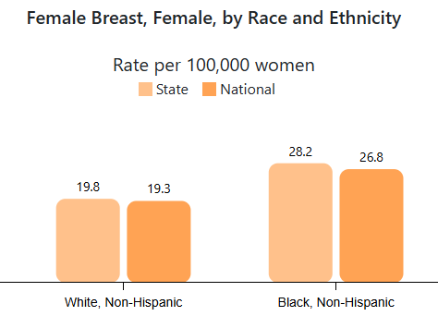
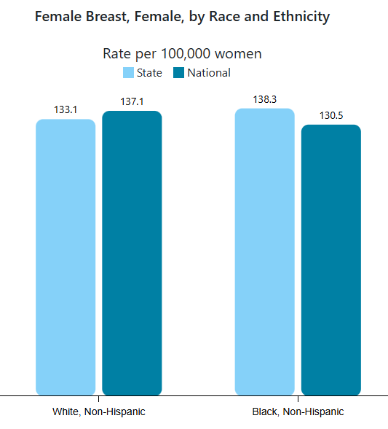
BREAST CANCER IN LA
Most frequently diagnosed cancer among women in LA and U.S.
Black women in LA have significantly higher incidence and mortality rates than their national counterparts.
Rate of Breast Cancer Deaths in Louisiana, 2019-2023
Rate of New Breast Cancers in Louisiana, 2018-2022
Source - U.S. Cancer Statistics Working Group. U.S. Cancer Statistics Data Visualizations Tool. U.S. Department of Health and Human Services, Centers for Disease Control and Prevention and National Cancer Institute;https://www.cdc.gov/cancer/dataviz, released in June 2025.

Slide 15
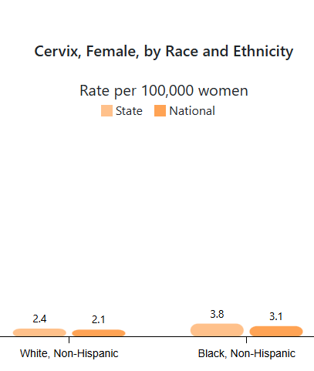
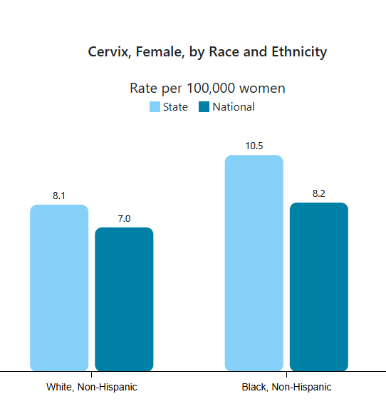
CERVICAL CANCER IN LA
Incidence and mortality rates of black and white LA women are significantly higher than their national counterparts.
Among women, cervical cancer accounted for 1.7% of all new cancer diagnoses and 1.8% of all cancer deaths from 2016 through 2020 in Louisiana.
Rate of Cervical Cancer Deaths in Louisiana, 2019-2023
Rate of New Cervical Cancers in Louisiana, 2018-2022
Source - U.S. Cancer Statistics Working Group. U.S. Cancer Statistics Data Visualizations Tool. U.S. Department of Health and Human Services, Centers for Disease Control and Prevention and National Cancer Institute;https://www.cdc.gov/cancer/dataviz, released in June 2025.

Slide 16
DATA ENTRY & PATIENT NAVIGATION REMINDERS

Slide 17
DATA ENTRY REMINDERS
Bi-annual submission is October 15th and we will submit with zero errors again! Thanks for all your hard work!
Remember to hold off entering cases into Catalyst until you have complete follow-up.
Reminder to fill out the diagnosis page if required (i.e. ultrasound, colposcopy, biopsy, etc. was completed)
Any questions? Please contact Zina Daniel (zdanie@lsuhsc.edu) or Malesa Pereira (mperei@lsuhsc.edu)

Slide 18
NAVIGATION REMINDERS
Two or more contacts are required for navigation, and preferably more for diagnostic cases.
Document all diagnostic patients in Catalyst to completion. This allows us to collect all required cancer data if the patient is diagnosed.
Care coordination is important. Touch-base with other navigators and other appropriate contacts to schedule follow-up tests and/or treatment as needed.
If any complicated or unusual situations with patients arise, feel free to call Tyler Bartley to discuss options or talk through program guidelines. She is always available to assist.
Review the CAGNO process and eligibility requirements. Feel free to call Tyler to discuss.
Reminder: All navigation is paid by program.
Notes:
Denise Cox

Slide 19
REDCAP REMINDERS
Referral emails are being sent from LBCHPinfo@lsuhsc.edu
Reminder notifications are sent out for 3 days and 1 week.
Update the patient’s status once you’ve made initial contact.
Be sure to include the patient’s Catalyst ID in the designated field.
Please add notes whenever possible. They are very helpful for tracking progress.
Any questions? Please contact Denise Cox (dcox6@lsuhsc.edu) or Malesa Pereira (mperei@lsuhsc.edu)

Slide 20
COMMUNICATIONS & OUTREACH

Slide 21
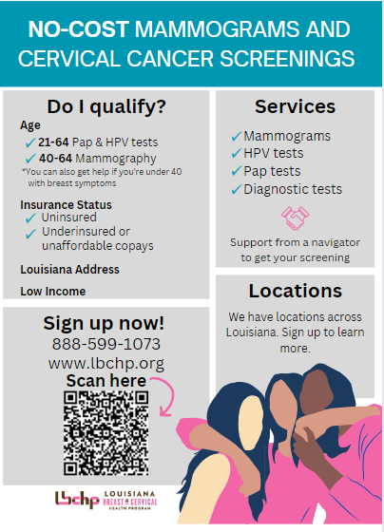
MARKETING MILESTONES
Minimum Requirement: Complete at minimum 1 new activity per quarter (total 4 or more for the year)
  Engage in a diverse set of activities for the year (i.e. combination of in-clinic/in-reach, outreach, and online)
  Some activities can be counted once; others can be completed and counted multiple times .
  For outreach or events remember to focus on LBCHP eligible population
✓
Notes:
We need your support to expand marketing and outreach efforts across the state so that women know about and can utilize LBCHP.
We’ve simplified the guidance and minimum requirements for MM. We hope that this makes it easier to identify opportunities for marketing and outreach

Slide 22
TRACKING & GETTING CREDIT
Email Brooke Stewart (bste10@lsuhsc.edu) by the end of each quarter with information about completed marketing activities.
  You will need to provide a brief description and documentation of activity completion.
  Credit for completing activities will be reflected in your quarterly scorecard.
LBCHP developed a table to help you track your efforts. You do not have to submit this table to LBCHP.
Questions or support with Marketing Milestones, email Leiana (lpined@lsuhsc.edu).

Slide 23
SAMPLE ANNUAL MM ACTIVITIES
Quarter 1
Quarter 2
Quarter 3
Quarter 4
Placed banner or LBCHP poster in waiting area
Re-shared an LBCHP post through the providers social media channels
Participated in a
health fair
Included LBCHP information within provider newsletter
Send a picture to LBCHP by end of Q1
Send a screen shot to LBCHP by end of Q2
Send a picture of event to LBCHP by end of Q3
Share a copy of newsletter to LBCHP by end of Q4

Slide 24
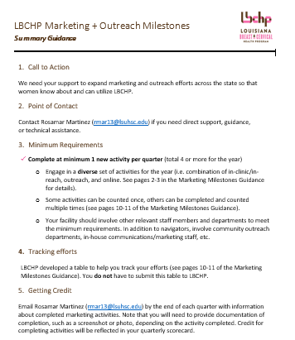
DUE DATES
Q1 - Send by September 30, 2025
Q2 – Send by December 20, 2025
Q3 – Send by March 31, 2026
Q4 – Send by June 30, 2026

Slide 25

BREAST CANCER AWARENESS MONTH
What are your plans ?
Social Media Campaign
  Will promote awareness and provide educational information about breast cancer through Facebook & Instagram. (@LouisianaCancer)
  Call to action – re-share our content.
Sponsored Message
  Goal: To direct women to the online referral form/RedCap
  Ad will run throughout October on Facebook and Instagram in certain regions (opportunities to collaborate).
Outreach

Slide 26
BUSINESS REMINDERS

Slide 27
REMINDERS
Submit accurate monthly invoices to the LBCHP business office e-mail address (lbchpbusiness@lsuhsc.edu) by the 15th of each month; final invoice will be due July 7, 2026 (date subject to change);
Submit invoices with all necessary supporting documents;
Submit invoices using only the LBCHP-provided template for the facility;
Communicate with the LBCHP business office to resolve issues with invoices or contracting; and
Contact the LBCHP business office as early as possible with any invoice/contract questions (e.g. reimbursable supplies).
Notes:
Additional professional development opportunities coming this year!
LBCHP Manual can be found on LBCHP.org.
Quarter 2 Check-in Calls will be scheduled soon.

Slide 28
ON THE HORIZON
Additional professional development opportunities coming this year!
LBCHP Manual can be found on LBCHP.org.
Quarter 2 Check-in Calls will be scheduled soon.

Slide 29
Q&A

Slide 30






LEARN MORE ABOUT LBCHP
1-888-599-1073
LBCHP.org
@LouisianaCancer
@LouisianaCancerPrevention
Louisiana Cancer Prevention & Control Programs

